Slide 1
Oh, I Just Use The Search Bar
Building a better website
Angele D. Mott Nickerson
Tom McMurdo
Vermont Department of Libraries

Slide 2
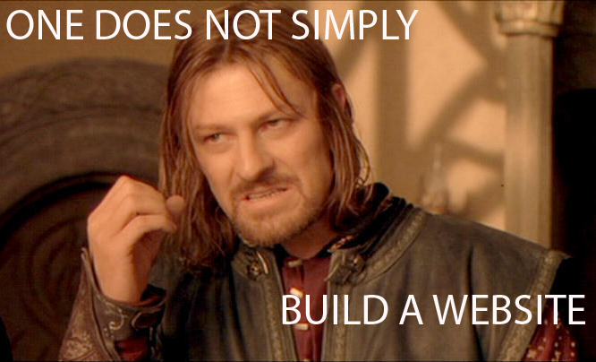
Notes:
It takes planning, patience, a little more planning. Creating a website that works means creating a website that works for users. When users have to use your search bar to find anything on your website you’re doing it wrong.

Slide 3
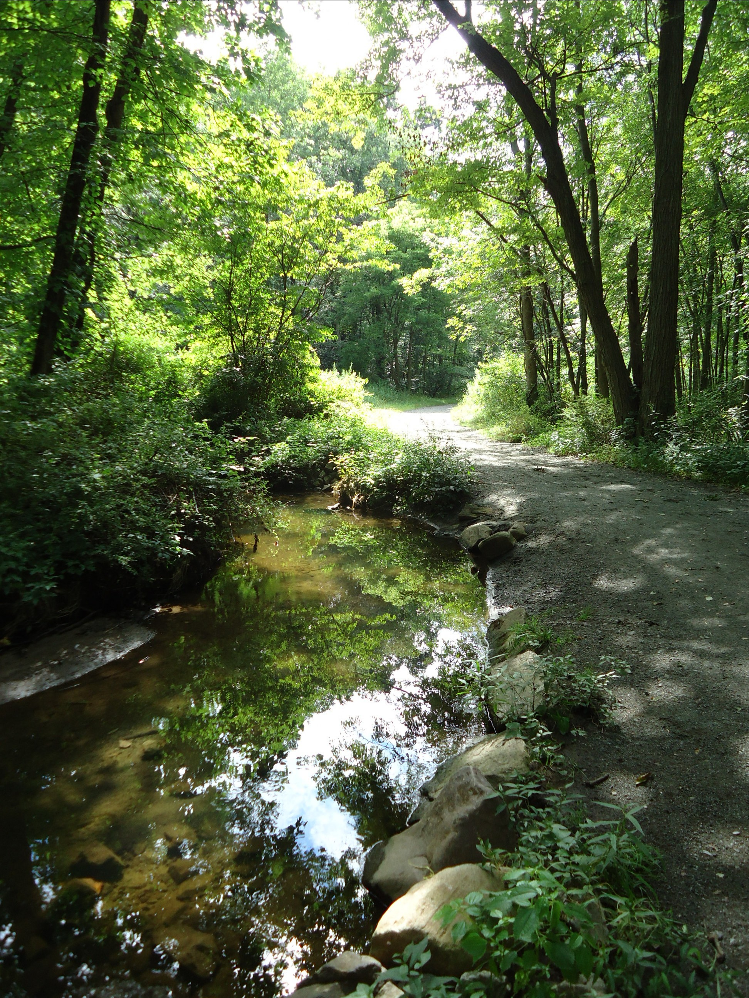
The Path We’ll Take
Project History
Project Layout
Content Design
Usability Testing
Questions

Slide 4
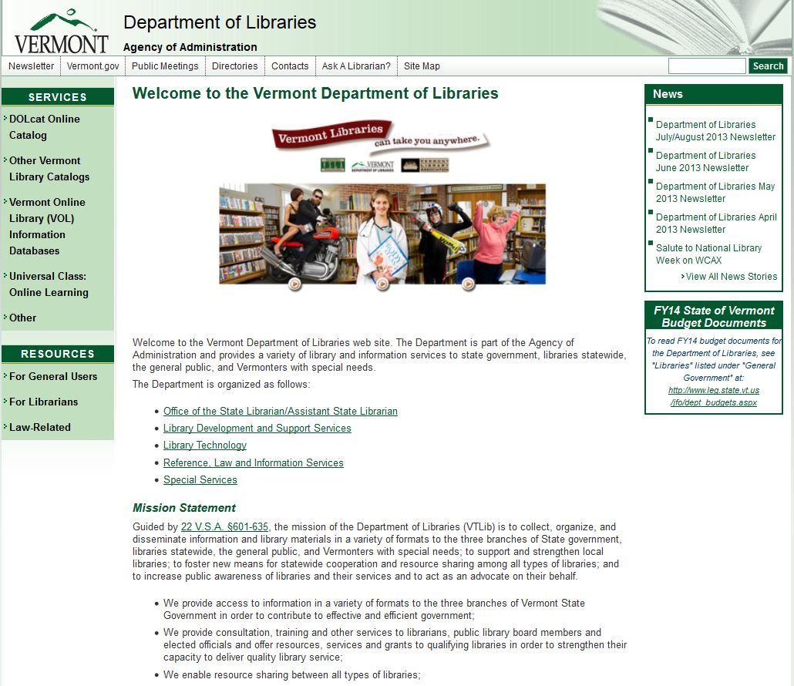
Project History
The Department of Libraries (VTLIB) site was tired.
Multiple new state website templates had come and gone. VTLIB still using the same old site.

Slide 5
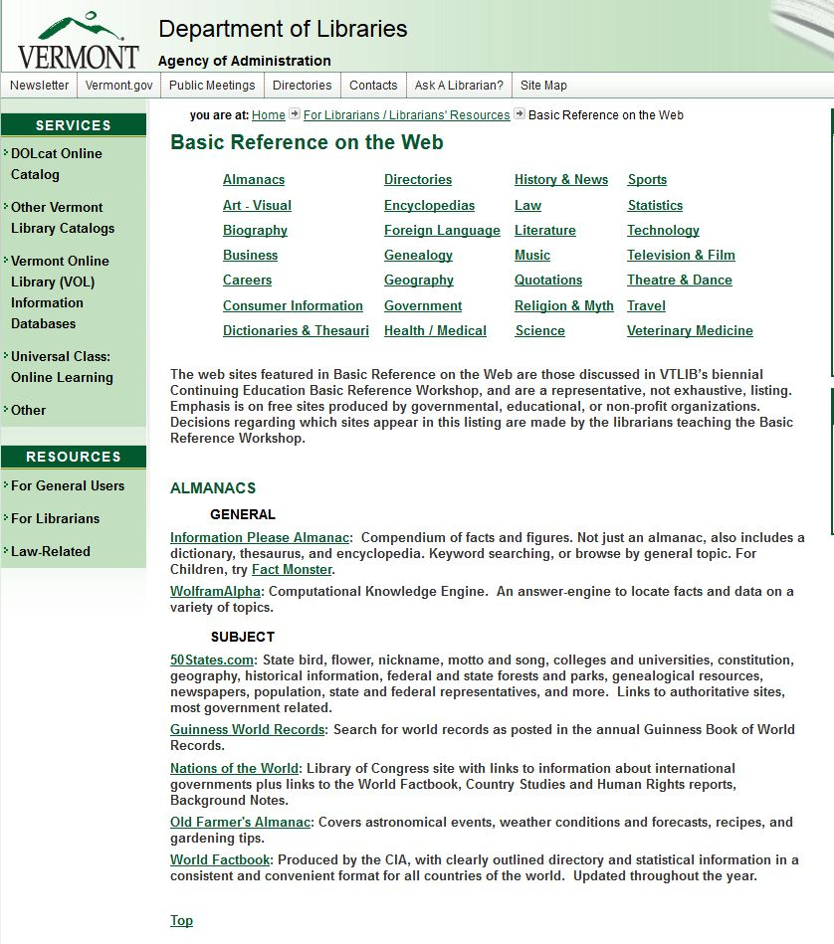
Like an old shoe
Comfortable, familiar for us and experienced users, but not for new visitors.
Visitors faced tremendously long lists. This page for basic reference is one of the more egregious examples:
The top of the list…

Slide 6
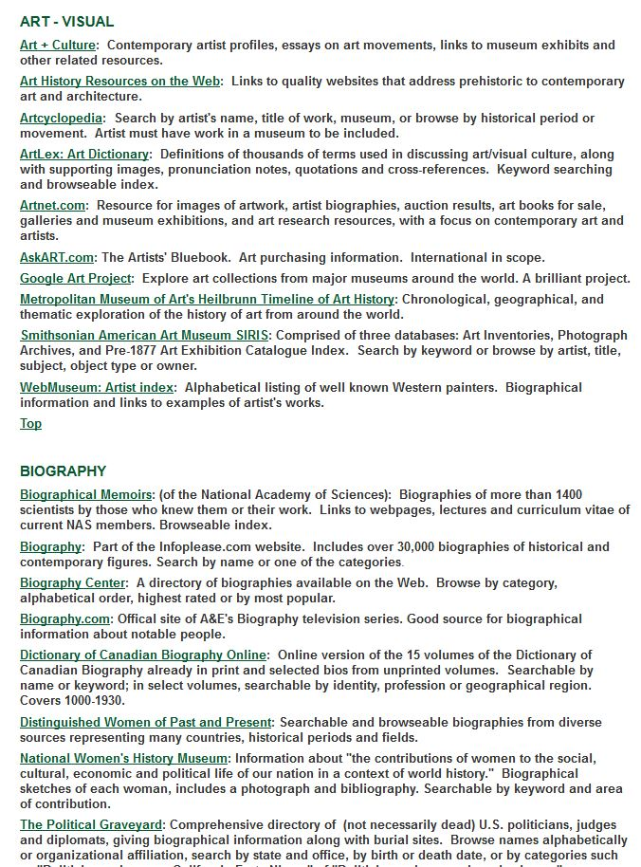
More…

Slide 7
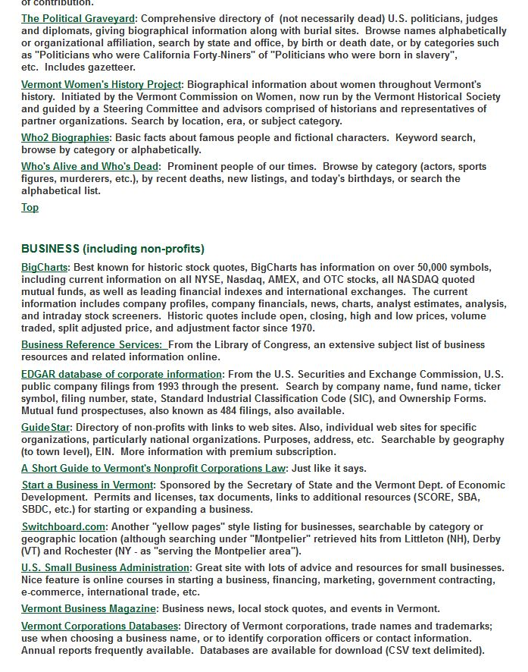
Still more…

Slide 8
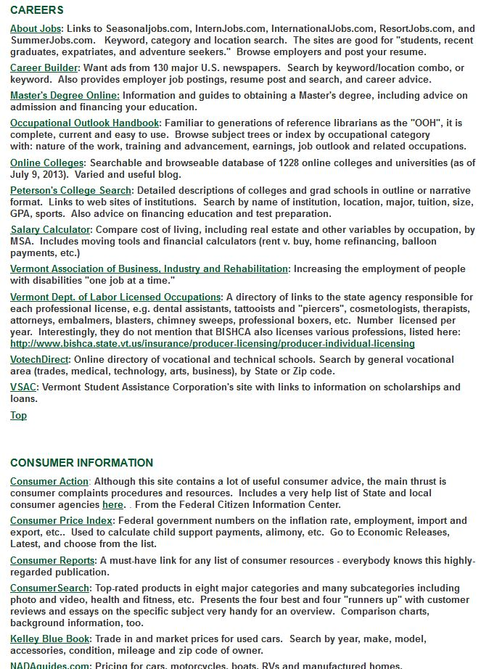
More…

Slide 9
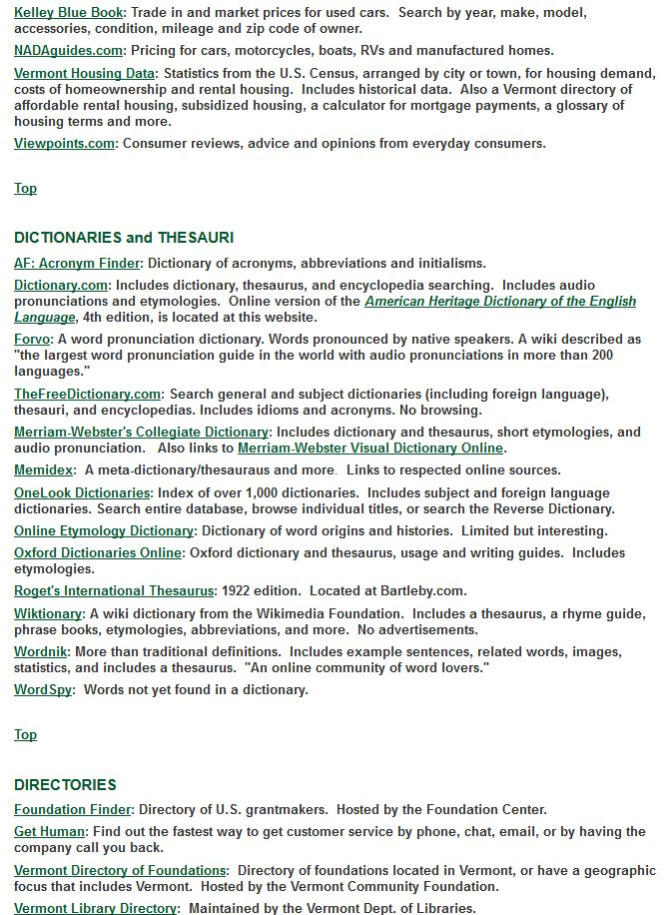
More…

Slide 10
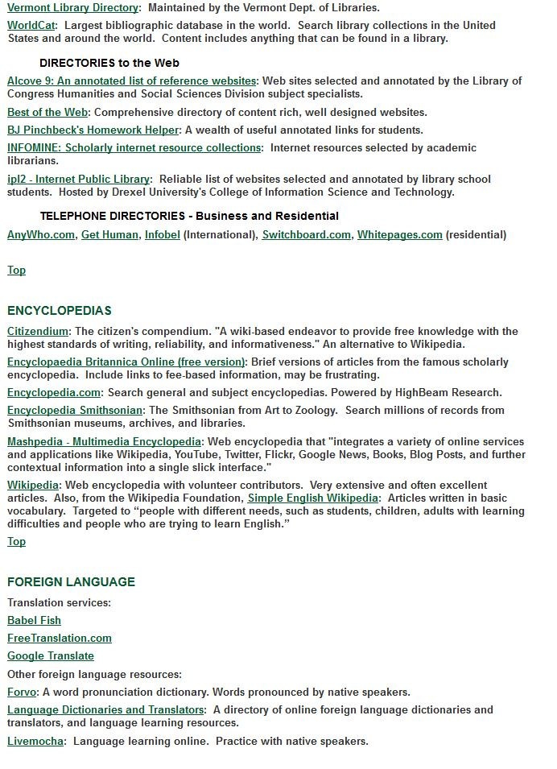
More…

Slide 11
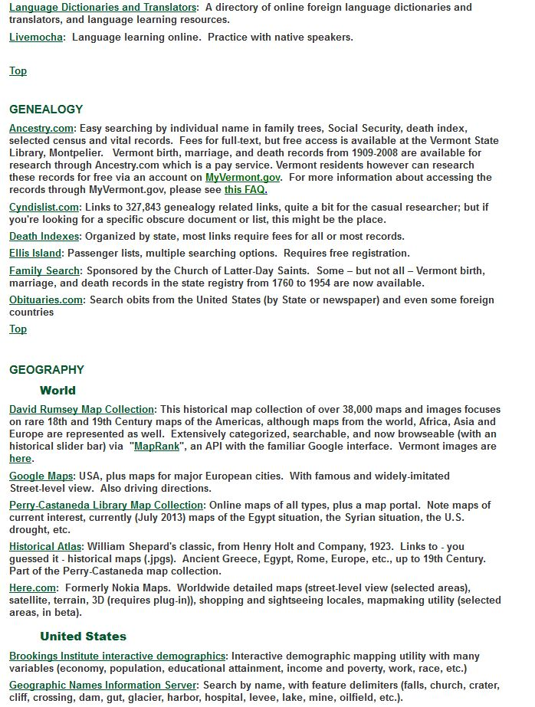
I developed a habit early on of just using the search bar to find what I wanted on our old site.
Just about halfway through and I got tired of doing screen captures.

Slide 12
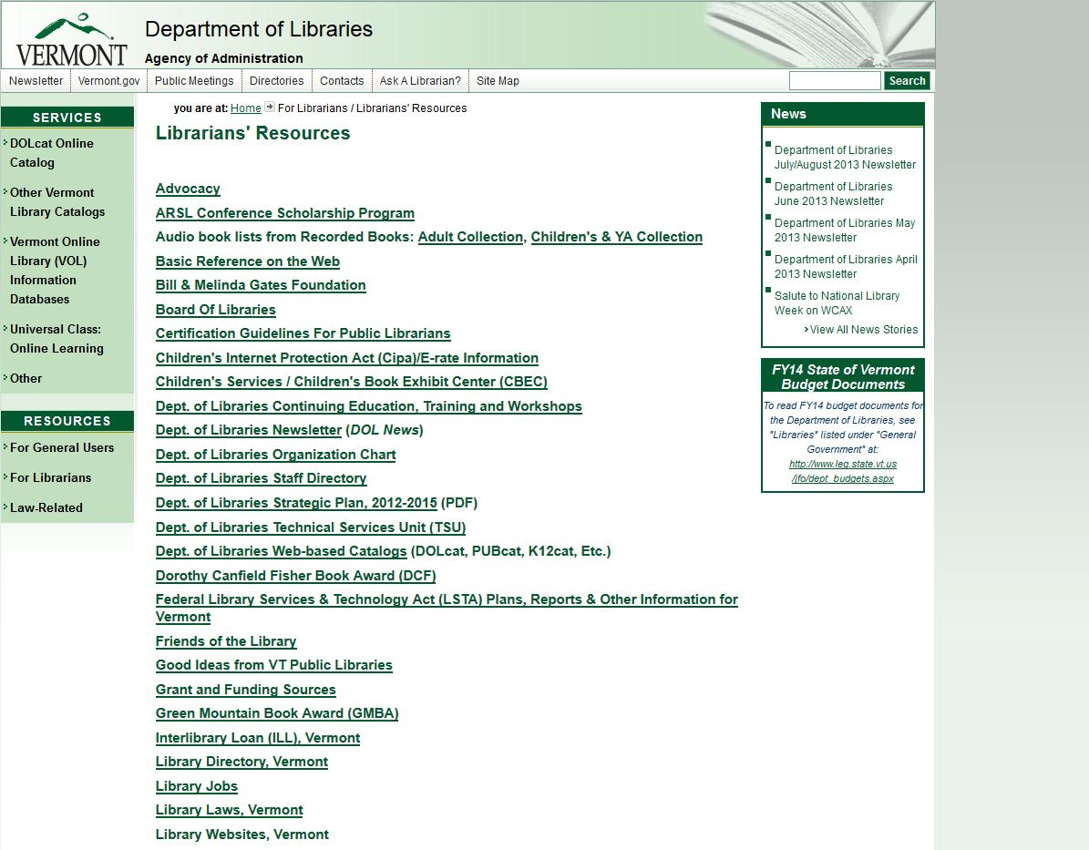
Change needed
We knew that we needed a new website.
But, the task was daunting. So much information on the site, warrens, old information, multiple servers, many authors, styles, types of information…
Librarians’ Resources

Slide 13
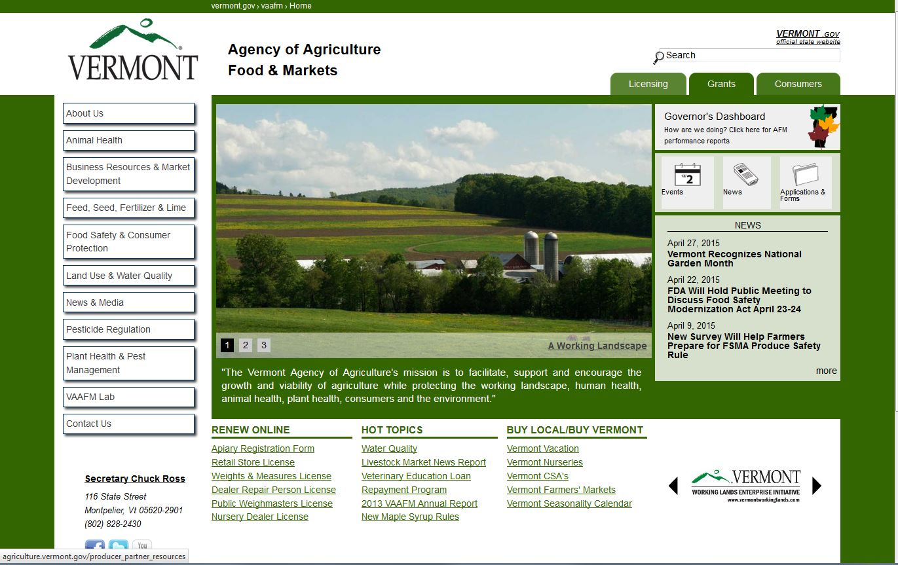
Choices
How to proceed?
Drupal is WYSIWYG, so how hard could it be? We can just do this in-house, right?
I’ll just drop everything for the next six to nine months and do this. Ha ha.
Agency of Agriculture site

Slide 14
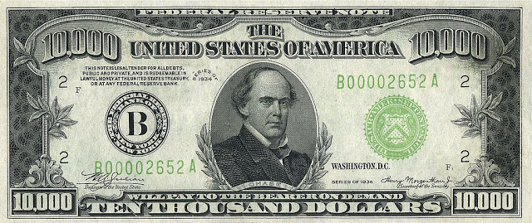
Choices
Hire a consulting firm? They won’t understand library issues.
Fortunate to be able to work with Angele Mott Nickerson, a librarian, to help design our site.

Slide 15
Project Planning
Know where you are headed or you are bound to get lost on the way. Or worse, not arrive at all.
  Project Goals
  Responsible Parties
  Timelines
  Necessary Documents

Slide 16
Project Planning
Project Deliverables
  Style Guide
  New Website
    Using New & Old Content
What happens if things go wrong?
  How will problems be reported?
  Who should they be reported to?
Responsible Parties
  Who is in charge?
  Who makes final decisions?
Reporting on Progress
  Weekly Emails
  Regular Meetings

Slide 17
Project Planning
Style Guide
Project Timeline
What to cover?
  Formatting
  Abbreviations
  Formality
  Little Details of Writing
How long do you have?
How will you divide the project?
Budgeting in extra time?
Checkpoints
Notes:
Style guide goal: everyone doing it the same, same face presented to the world, website is uniform, Formality: how will you address your audience, Details: how do you write dates, times, place names, ect. Checkpoints: Have stop points (100 hours, 1 month, whatever) to determine where you are and if the timeline needs to be adjusted. I went from 1 month to 3 months to 7 months. While these items should be covered in the written project plan, they should fully fleshed out separately in their own documents.

Slide 18
Style Guide
Writing Style
  Friendly, yet professional
  Short paragraphs
  Fewer words
  Avoid library jargon
  Speak directly to the reader
Strong Organization
  Use headings and bullet points
  Leave white space
Images
  Use in place of words
  Use lots of them
  Issues of copyright
Word Choices
  Avoid abbreviations
  Standard for dates, times, and other commonly used words

Slide 19
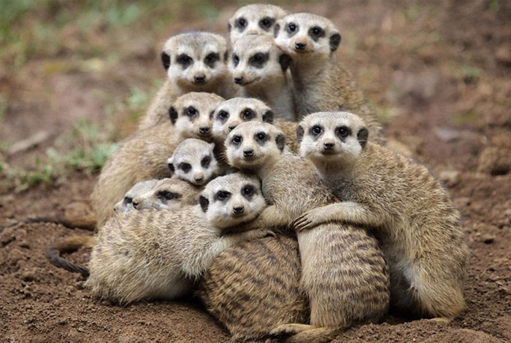
Sharing and Training
Notes:
This is what staff will look like when you change things. So share and train and explain the new style guide.

Slide 20
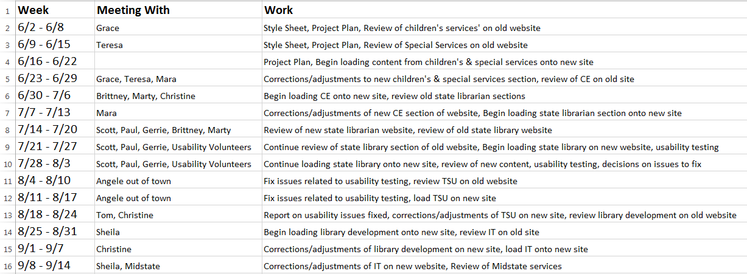
Project Timeline
Notes:
Doesn’t have to be fancy, just needs to get the job done. This also helps in other’s planning as well. If people know you’re working with them they can plan their schedules and get their work done, you can work around other meetings and vacations, ect. For the overall timeline you’ll want to include things like when you’ll do usability testing, time for fixing issues, employee training time, and extra weeks for when everything is running behind.

Slide 21

Digging Around Your Website
Website Content Audit
Find out what content already exists on your website.
Notes:
Got the paperwork figured out, so how do you start working on the site? I assume you have an old website you’re working off of. So start by digging down deep into that site to see what you have. I did this section by section. Who ever I was working with for the coming few weeks I first set down with them and went over all the pages on the current website that they were responsible for or somehow related to their job. Probably a better approach would be to do this up front to get an idea of the total content.

Slide 22

Oh’ The Things You’ll Find….
You cannot fix problems if you don’t know where to find them.
Use the audit as a discovery tool.
Notes:
I know you don’t want to do this, it sounds boring, and tedious. It is. But you need to know what exists, what bad habits are present, and you’ll also likely discover information on how your library is working since the website is just an outward example of the inner workings of your staff. Examples from VTLIB: expensive server didn’t know they were paying for, multiple people working on same project producing not the same information, very old and out of date info.

Slide 23
Organizing A Website
Home Page
Services For Libraries
Public Libraries
News and Data
Online Resources Library
Online Classes and Learning

Slide 24
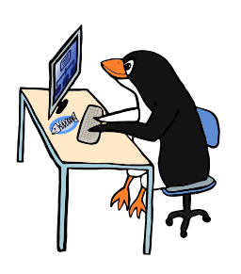
Website Work
Review of current website content
Meet with individual responsible to discuss current and future content
Provide individual with list of content I needed from them and deadline
Receive and organize content on new website
Review with responsible parties
Final edits and now moving on
Notes:
That’s me being chill because things always worked exactly as planned.

Slide 25
Website Work
“I’ll get back to you later with my work.”
“But ALL of this content needs to be there.”
“I never did it like that before.”
“We’ll just change it back when you leave.”
Consult your project plan
Go over the style guide
Talk about the ultimate goal of a better website
Tell them usability testing says we do it this way
Notes:
Luckily I could point to the library’s website and ask, “is this really what you want?”

Slide 26
Website Work
Timeline
Images
Chasing people to get their work
Keeping limits in mind
Constant edits
Consult the project plan
Ask questions, lots of questions
Created “Go Back & Fix Later” document
Used usability testing to settle disputes
Let some things go
Notes:
Personal challenges

Slide 27

Content Design
What do website users want to see?
  Strong top-down organization
  The ‘F’ pattern
  Multiple discovery methods
  Simple words
  Images
  Clickable links
Notes:
While I wanted everyone to have an overview of the process the Dept followed to build the site I also want to provide information on two other important components to website design. When talking about the style guide and website layout I want to share with you some basic best practices to consider when creating content for your site. In terns of usability testing I will talk about how we did this as part of the new Dept website and why it is so important.
There are as many ways to layout a website as there are people. However humans have quickly been trained to look at websites in a particular way. Keep these things in mind prior to starting the design. Of importance is the organizational structure. Before building the website the state determined the first two layers of the website and new pages/content were added from there.

Slide 28
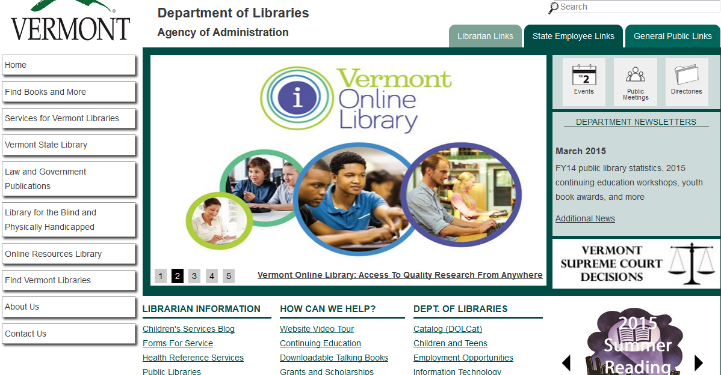
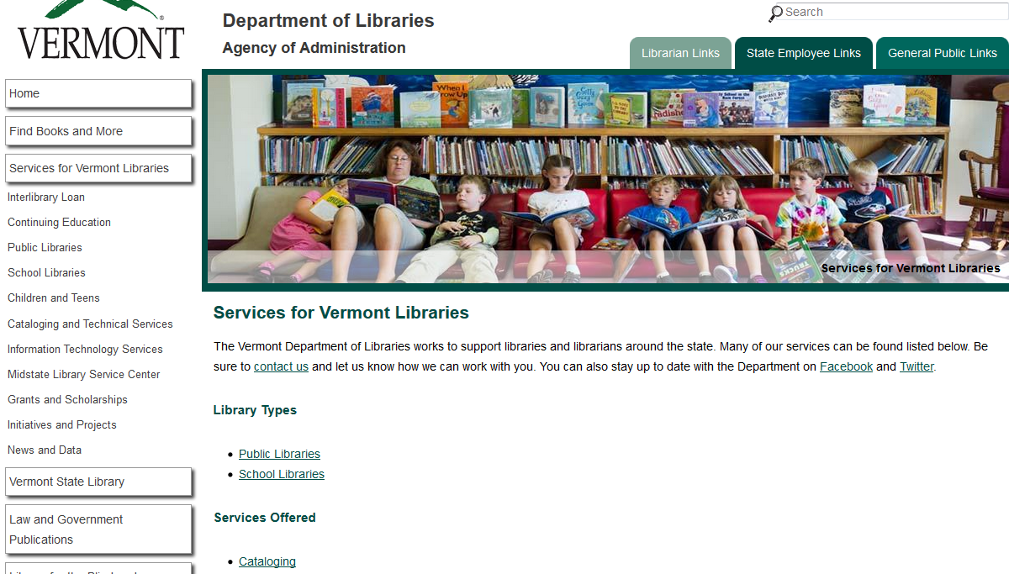
Notes:
A number of the issues I noted as things users look for can be found on the home page of the new Dept. of Libraries’ website. (point to examples) The goal of all of these features is to decrease the use of the search bar. Lead people easily around the website, make it easy for them to find what they’re looking for.

Slide 29
Displaying Content
Don’t
Do
Long Lists
Too many words
Use lots of abbreviations
Too formal or too casual
“Click Here” for link title
Use bold and/or italics
Disorganized content
Bullet Points
Get to the point quickly
Be clear on who and what
Professionally friendly
Tell users where a link goes
Choose an easy to read font
Use headings to organize a page
Notes:
These topics can also be covered in your style guide so there is a record of how content is displayed online and so everyone is aware of how things work.

Slide 30
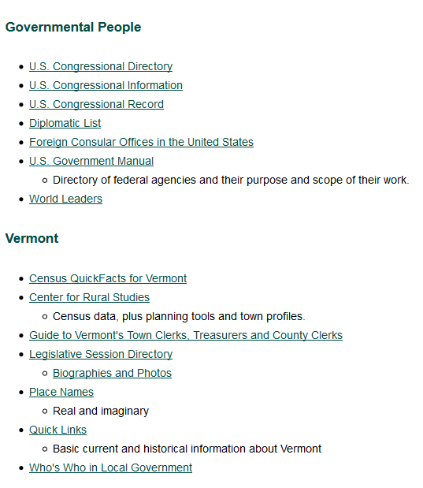
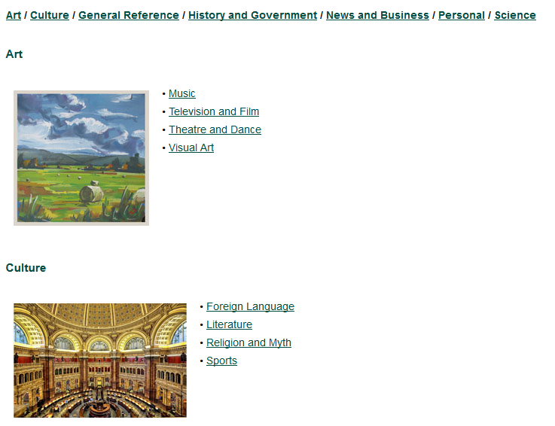
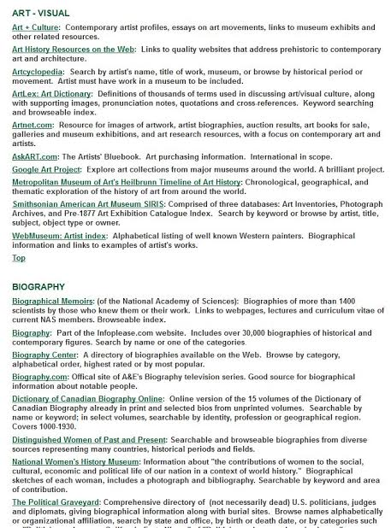
Notes:
Images of Dos & Don’ts: Image of library service list then new navigation tool; image of old reference list, then new reference list; too wordy page, show use of headers/page organization

Slide 31
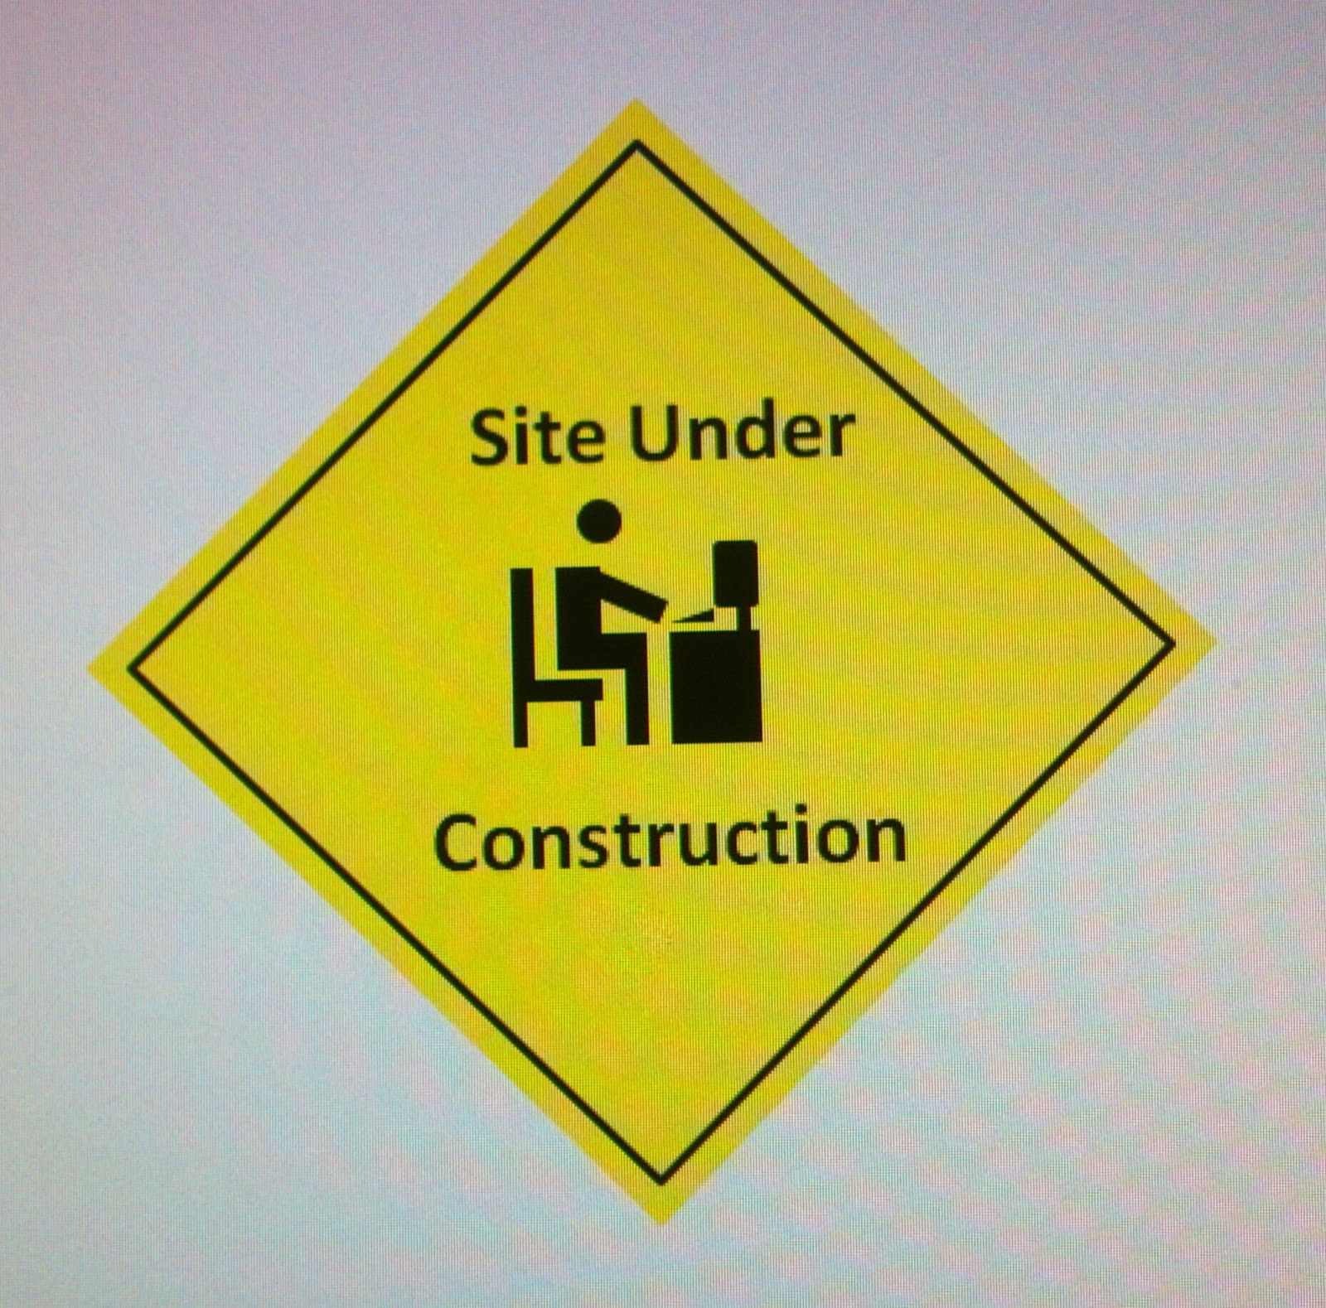
How Do You Know It Works?
Try it out! See what happens!
Usability Testing

Slide 32
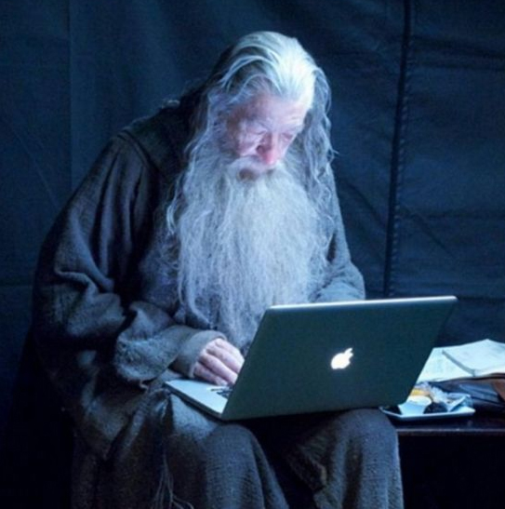
Why Usability Testing?
Get you out of your bubble
Find problems
Determine user needs
Settle disputes
Confirm previous fixes

Slide 33
How Does It Work?
Choose your volunteers
Determine task based activities
Make clear to volunteers their role in testing
Don’t let volunteers use the search bar
Ask for suggestions
Does not need to be difficult. Just need a computer and paper to take notes, you will learn a lot

Slide 34

Notes:
First round of testing

Slide 35
Department of Libraries’ Testing
Three rounds of testing
Written notes and screen capture recording
Written report of testing results
List of changes made
Retested problem areas
Most important thing the Department did to improve the quality of their website

Slide 36

Always More To Learn
Project Layout & Timeline
Policies, Procedures, & Documentation
Website Design
Usability Testing
Notes:
I’ve tried to cover a lot of ground today and there is a lot more to be said on each of these topics. But I wanted to give a good overview and also leave time for questions.

Slide 37

Time For Questions

