Slide 1
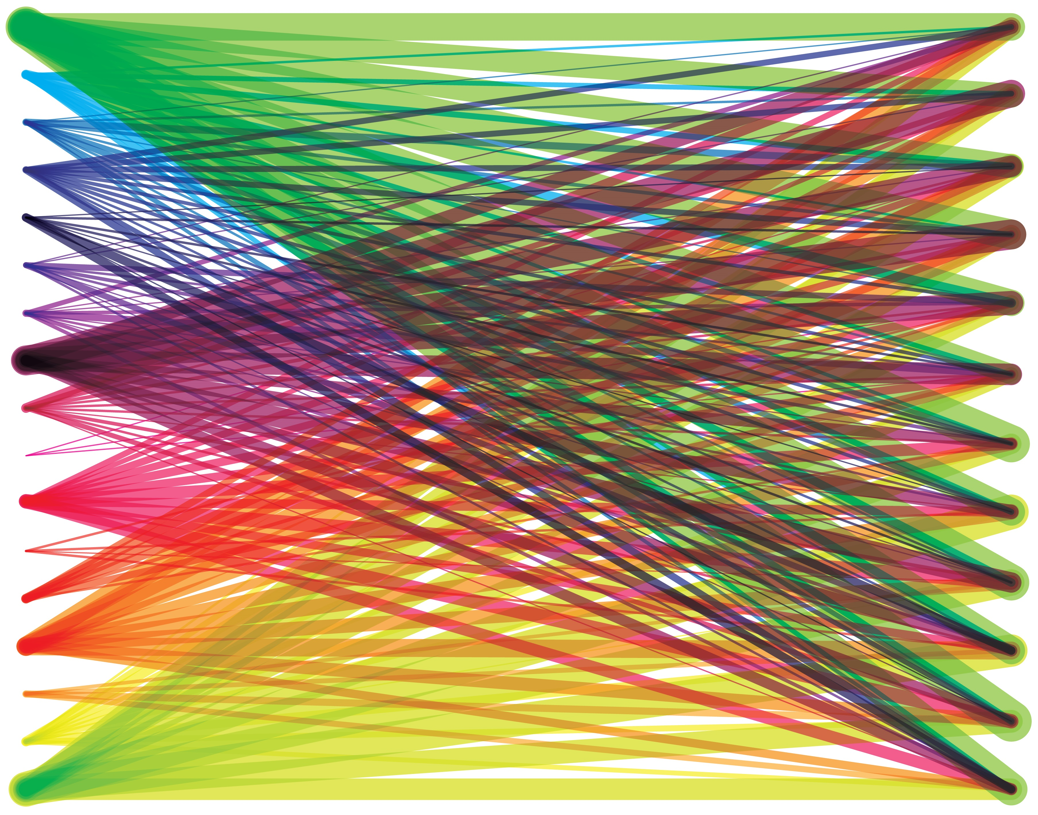
Actionable
Data
Helen Linda, IT Business Analyst
State of Vermont – Agency of Digital Services
124th Annual Vermont Library Conference
May 18, 2018
Adapted from CONNECTING LINES image by Lauren Manning, CC BY 2.0, https://www.flickr.com/photos/laurenmanning/5659594528

Slide 2
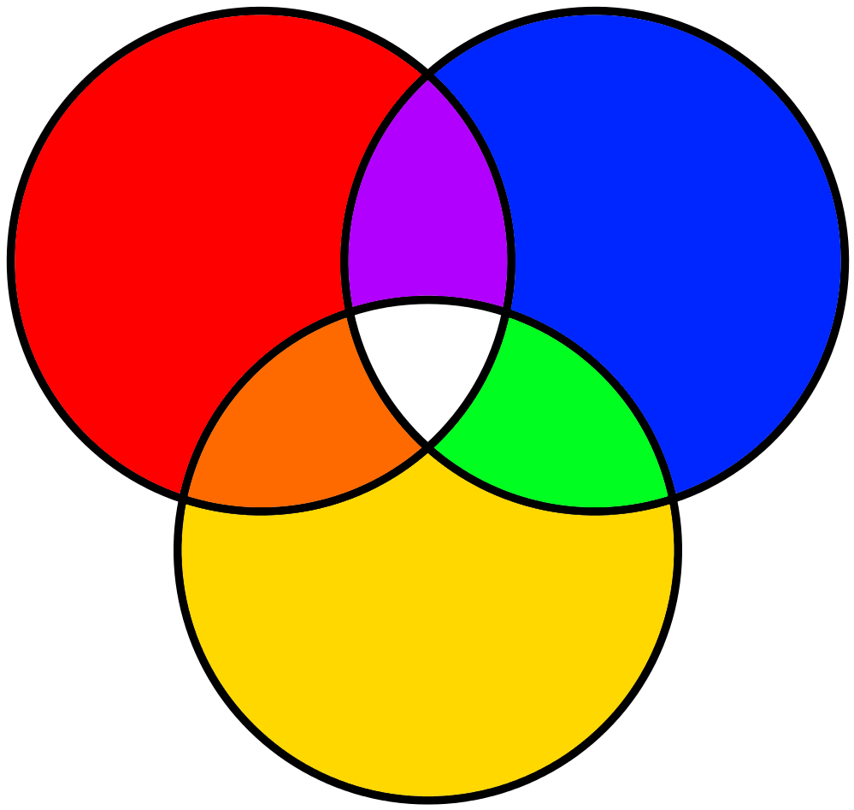
Business
Analyst
Librarian
SOV PIVOT
Adapted from image by JesperZedlitz - Own work, Public Domain, https://commons.wikimedia.org/w/index.php?curid=3741799
Notes:
My name is Helen Linda, I am a former librarian of about 18 years, most of which was spent working in Vermont as a tech services and systems librarian. I was a project-oriented librarian, always geared toward changing and tweaking things. That strong technical background and project orientation is what eventually led me to business analysis. Business Analysts are basically translators, straddling the space where innovation and business practice meet. We set about understanding how and why people do things the way they do, deliver models that make that work visible and understandable to anyone, and empower all parties to meet genuine needs as they innovate and move forward. We put in the hard prep yards that helps business succeed in projects in the future. Since I joined the State of Vermont two years ago, I’ve been a part of their PIVOT initiative, which trains state employees to assist each other with improvement and efficiency initiatives statewide.
It is from the nexus of all those experiences that I’m bringing this workshop. I am still relatively new to all the things I’m about to share, but at least once a week since I started learning them I’ve thought, “I wish I’d known this when I was a librarian!” If I had my projects would have been more successful, more impactful, taken less time, and it would have been easier to articulate their value.

Slide 3

Objectives
Collaborative information gathering
Getting to root causes
Acquiring specific baseline data
Acting on greatest impact
Image by Deedster – CC0 Public Domain, https://pixabay.com/en/target-dart-aim-objective-success-1414788/
Notes:
Today we’re going to explore:
Collaboratively gathering information about a problem or opportunity that arms us with a whole picture to act from instead of a small picture to react to
Ways to drill down to the root cause of a problem or opportunity so that you can ask a more salient question
How to acquire baseline data that is tailored to that question
How to use baseline results to focus on areas of greatest impact

Slide 4
Unscientific Method
Reaction
Assumption
Solution
Implementation
Begin
End
Notes:
This is how a lot of problems get solved:
Make an observation about a piece of information and react to it
Assume that interpretation of the information is correct
Seek the fastest possible to solution to satisfy the assumption
Implement the solution and hope it solves the problem
There are some clear pitfalls to this method:
A single observable piece of information is an iceberg. If you’re reacting only to what you can see, you’re missing 80% of the issue. How can you know you’re reacting to the right thing?
Working on assumption leaves you and your institutions vulnerable to wrong conclusions and wasted efforts and it is definitely not challenging to bias.
Jumping to a solution before evaluating all possible causes leaves you at risk for solving the wrong problem entirely.
Implementation of a shaky solution means you may spend a lot of money and waste a lot of staff time and not even solve the real problem, or worse, compounding it.
A couple of common ways I’ve seen this play out:
New ILS Migrations – so many complaints about “the system” can be traced to problems of the human process. A new system simply can’t solve the problem of a bad human process, and usually only amplifies it. Then we complain that it wasn’t worth and knew it wouldn’t work and it’s that much harder to get buy in for a new system down the line, even if chosen well.
Policy or Procedure Changes – how many times have we enacted what seemed like a small policy or procedure change based on what one specific staff member sees on their specific shift, from their specific perspective, doing their specific job, and found that it had a complicated ripple effect or unintended consequence at the global level?
Programming – again, developing a program based on an observation of patron need and then that program flounders or fails, creating a situation where a lot of time and effort has gone into something that might not have been needed, or the need was not quite interpreted in the correct way.
I’m sure you can think of plenty of examples, but let’s look at one of mine.

Slide 5
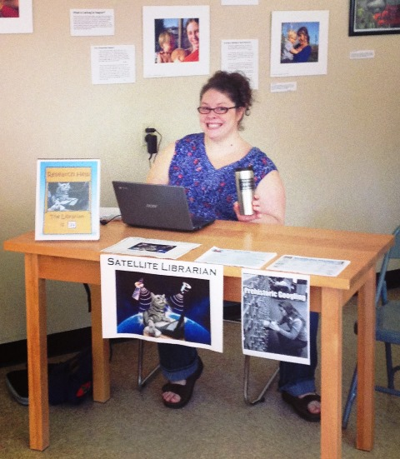
Real Life Example
Reaction to: survey downtrend
Assumption that: need programming
Solution is: remote reference service
Implement as: pilot project
Image by Samantha Kolber for Goddard College
Notes:
The biggest problem with the unscientific method is that it arguably works! As an example from my past life, here’s the most popular program I ever dreamt up. I am still really proud of this program and what it said about my instincts for patron-centered librarianship.
In 2013, I proposed a remote reference service pilot project for Goddard College in response to residency evaluation results showing increasing dissatisfaction from students over time, both in the raw numbers and in the optional comment data. I reacted to the data by assuming that librarians needed a more visible presence on main campus, which would address comments that the library is too far and inaccessible. I wrote up a pilot project using the residency survey as my baseline data and based on the specific program evaluation at the end of the pilot, we concluded it was successful and made it a permanent offering.
So why am I choosing this project, by all accounts my most successful effort in project management to date, to look more closely at? Because even popular programs can be bad science. Just because it’s popular doesn’t make it successful.

Slide 6
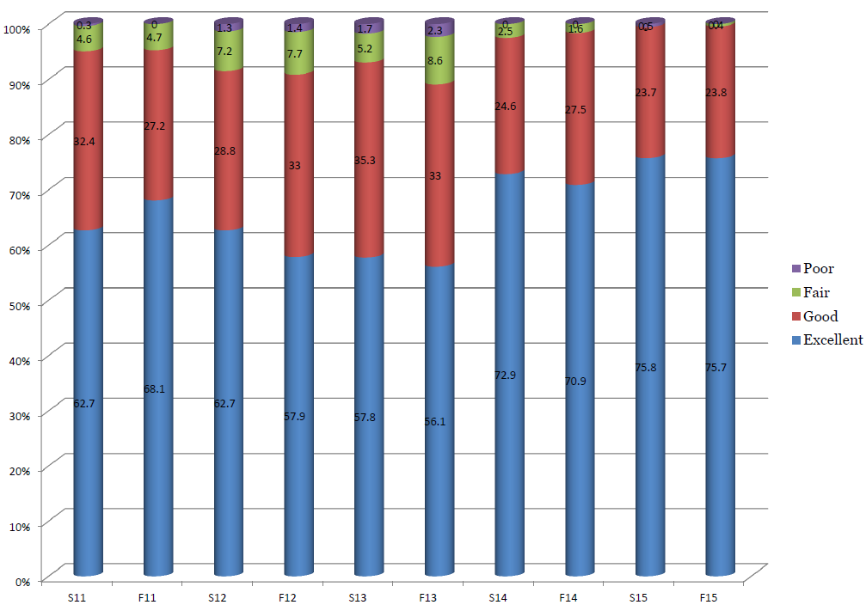
Evaluation Results
Image by Helen Linda from Goddard College library report data
Notes:
This graph shows the numerical data from the college residency satisfaction survey specific to the library. Look at that beautiful jump in satisfaction between the fall 2013 and spring 2014 semesters! Who wouldn’t think this program was a success?!?
Learning business analysis, project management, and process improvement processes and tools has shown me how I put this project together in a very problematic way:
The student survey doesn’t have a high response rate, and it’s an over-general survey. So, building a global initiative to this data alone is catering to the vocal few.
I took my assumptions of what this data meant and went straight to a solution, skipping right over all the possible collaborative interpretations of the data.
This data is broad but I used it as the baseline to support a specific initiative. Then I went back to the original broad data to prove the initiative success. It’s comparing apples and oranges.
By building the program and argument primarily on my own interpretation of the results, I’m did not challenge my own bias and personal preferences for solutions.
The library went through a lot of changes at this time, from staffing to other patron centered programs meant to address this issue. There’s no way prove my program did the trick.
This program spread a thin staff even thinner to cover two locations. Unless it’s addressing a root problem, possible this program is taking away from staff ability to address bigger issues.
So, all this data tells us is that we did something right, or that something went right whether we did it or not, but not what, how, when, who, why, or any other measure that we can use to prove we got it right.

Slide 7
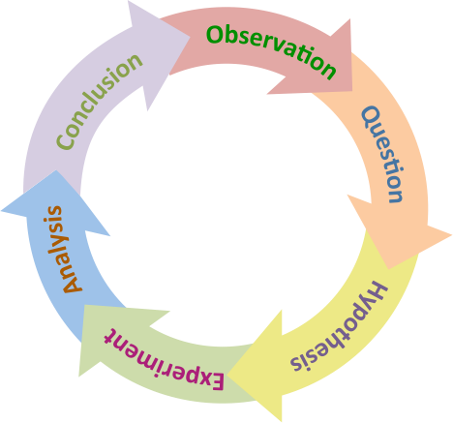
The
Scientific
Method
Image by Thebiologyprimer - Own work, CC0, https://commons.wikimedia.org/w/index.php?curid=50625082
Notes:
Why reinvent the wheel, the scientific method has had it right since the 17th century.
The unscientific method skips right over unpacking observation, developing a specific question, and forming a testable hypothesis. So, for today, we’re focusing on the first three parts, because it will form a solid foundation for any decisions that come after it.
This process of slowing down to really focus on getting to the right place can be a little painful. It assumes some things that we may take for granted:
It’s very hard to reconcile that what we see and interpret from our own observations may not be right. That’s why we try to get to root causes. Intuition on it’s own is not enough.
It’s more work to be collaborative, but this process works best if we work together to get the widest matrix of information to work from instead of what our own mind limits us to.
It’s human nature to see a problem and seek solution immediately. However, we skip a lot of important conversations about whether we’re even solving the right problem.
Just because something is popular doesn’t mean it is successful.

Slide 8

Do Over
Observation: collaborative matrix of interpretations
Question: root cause to develop specific question
Hypothesis: develop and acquire baseline data that answers that question
Original uploader was Zir at English Wikipedia - Transferred from en.wikipedia to Commons., CC BY 2.5, https://commons.wikimedia.org/w/index.php?curid=2747260
Notes:
If I had it all to do again based on what I know today:
Don’t react – consider the data collaboratively with all library staff and a representative sample staff, faculty, and students. Get the widest possible matrix of information to draw from
Pattern recognition – see what major themes pop up, what observations are made repeatedly over the widest audience, and choose that observation to explore first
Root cause – The most common observation may be a superficial symptom of a larger issue. I’d use a tool to drill down to the true cause of that observation instead of taking it at face value.
Specific question – once we have the root cause, what question or questions do we have about it
Baseline data – develop measurements that answer that specific question, then collect a bunch of data points that answer that question specifically
Prioritize – take the raw data and prioritize it using a tool to show where the most impact would be
Action – develop a plan of action based on the highest priority item or items, ensuring that staff and budget are being used in the most impactful way possible
Forget about the solution for now, you haven’t gotten there. Consider getting to a solution an effort in drilling down from the most possible information to the most precise testable hypothesis and then, once there is proof to back up that hypothesis, then you can consider solutions.
And, if there’s no proof, back to the observation pool and take another tunnel to a different hypothesis.

Slide 9
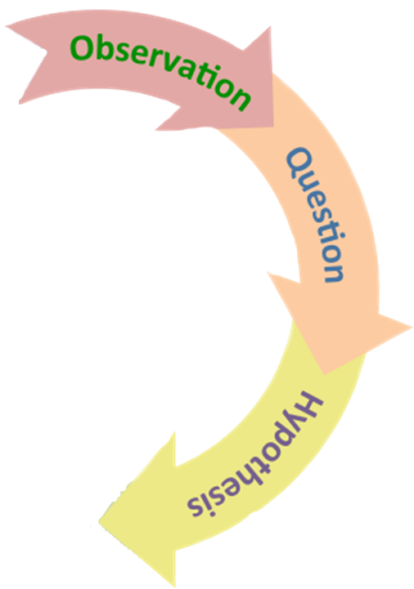
Toolkit
Finding all the information
Interviewing and Listening
Drilling down to the root cause
5 Whys and Fishbone Analysis
Developing meaningful data
Performance Measures and Pareto Analysis
Adapted from image by Thebiologyprimer - Own work, CC0, https://commons.wikimedia.org/w/index.php?curid=50625082
Notes:
If I really got a do over, I’d assign these tools and methods to it. These are some of my favorites but this is by no means all or even most of the ways to can do this. If you don’t like these tools, or they aren’t right for the kind of problem you’re solving, get out there and research some more appropriate tools. There are so many different ways to do this work
Observation is about collaboration and interviewing skills. As many people as you can, probing them for all they think on the topic
Questioning is about getting the right, specific question and we get there using root cause analysis. 5 Whys is a very simple way to do it, fishbone is a little more complex
Hypothesis is about developing and collecting baseline data that will provide answers to your core questions. Performance measure activities help develop the right data for your specific question and pareto analysis helps sort and prioritize the data in a form that is highly impactful and visual.

Slide 10
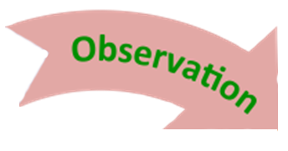

Keywords: 5 W’s (+H), Consultative Interview, Reference Interview
Use: Open Questions
Avoid: Leading Questions
Image from ArtRocks blog - http://art-rocks.blogspot.com/2011/03/five-ws-and-one-h-of-notebook-movie.html
Notes:
Observation is all about putting in the hard collaborative work of collecting all of the possible observations and interpretations.
Start with you – honor your curiosity by articulating what you think about it and collecting you first. If it’s easier, get someone else to ask you the probing questions so nothing is missed
Don’t stop until you collect them all – figure out every possible angle and stakeholder in this inquiry and get all the information you can. Representative sample is fine, but if it seems like the sample is too small, get creative about how to get more.
Reference Interview – remember when we all learned about helping patrons with open-ended questions. Interviewing is interviewing. If you stick to the 5 W’s and ask open-ended questions, you’ll juice the best info from your subjects.
Leading Questions – Don’t do this. It’s super tempting, but we’re not winning hearts and minds at this stage, and we don’t want to skew the results by trying to convince anyone of anything. You are an open vessel.
Examples of leading questions:
Don’t you think that…
Why don’t you…
Isn’t it better to…
Wouldn’t you like to…
Have you though about…

Slide 11

Keywords: Active Listening, Informational Listening
Use: Repeating back
Avoid: Judgement
Image by Fred Seibert - Own work, CC BY-NC-ND 2.0, https://www.flickr.com/photos/84568447@N00/26156079281
Notes:
The flip side of asking open-ended, empty vessel questions is really listening to the answers, both those spoken and implied
Active listening – this technique is used a lot in conflict management and counseling. Concentrate on what the person is saying, understand it, demonstrate that understanding
Repeat back – this is the most important part, if you can’t get agreement that you’ve accurately understood, then you can’t prove you have the right observation/interpretation
Judgement – you’re going to hear a lot of opinions that are not your own, so practicing listening without judgement of what you’re hearing is the only way to get an unbiased collection
Sort and count– what observations or interpretations come up the most. A simple sort into categories and count will do to find the biggest rabbit hole to jump down
Examples of active listening repeat backs:
Tell me more about…
Let me see if I understand…
What I heard you say is…
Could you say more about…
How do you feel about…
What do you think about…
Let me see if I can summarize…

Slide 12
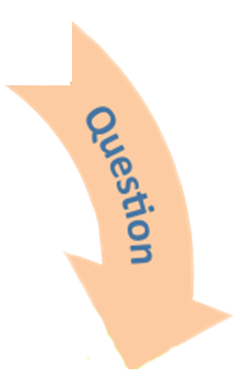
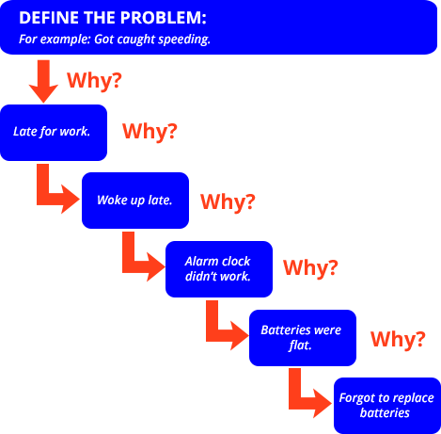
Keywords: 5 Whys, Root Cause Analysis
Use: Simple Problems
Avoid: No known solution
Image from CareerToolbox website - https://careertoolbox.com/careertips/5-whys
Notes:
Now that you have used pattern recognition to identify the biggest seeming issue, let’s drill down to the actual issue:
5 Whys – this simplest of root cause tools and quick to use
Simple Problems Only – a simple tool for a simple problem. If it feels over simple, it probably is
Common Sense – if you arrive in a really weird, non-sense place, then this tool is probably not the right one. That’s fine, just try something else

Slide 13
5 Whys
Define the Problem: Must be answerable
Type of Whys: Logical/sensible questions
How many: Can be more/less than 5
Branching: Maybe fishbone instead
Test Logic: Why down, because back
Span of Control: What’s in yours?
Conclusion: Treating diseases not symptoms
Notes:
Your problem needs to be solvable. No philosophical debates or existential crises like “Why do bad things happen to good people?”
Your whys need to be logical. It’s tempting to treat this like a juvenile activity, but handled with humility and grace, it can really get the job done.
You can drill down as far as you need to, the root cause may be further away or nearer than you think. Stop when it feels like you’ve really uncovered something. You can always go back and drill further or back up in the future.
If the problem seems to messy for this simple tool, it probably is. If you have too many possible branches of questions, try using a fishbone or concept map instead.
Once you’re at a good place, make sure you test it in reverse. A “why” going down should have a corresponding “because” going backwards.
If you drill down to a level that is outside of your control, go back up the ladder and start with the closest root cause in your purview.
Once you find the root cause of the original problem you identified, choose to solve the more specific root problem instead of a symptom.

Slide 14
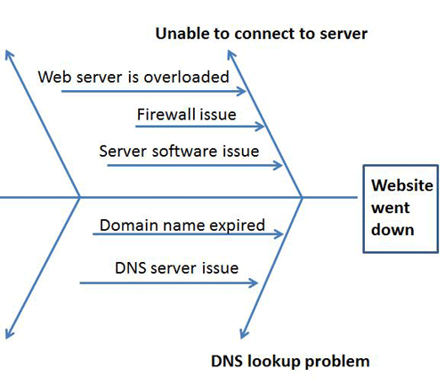
Keywords: Fishbone Analysis/ Ishikawa, Concept Mapping
Use: Multi-stream problems
Avoid: Too deep
Image from WhatIs.com website - https://whatis.techtarget.com/definition/fishbone-diagram
Notes:
Fishbone/Ishikawa analysis is more about blowing up a problem than drilling down:
Multi-stream issues: if you’re problem has a lot of possible questions, this can be a great way to identify all the different areas
Use together with 5 whys: use 5 whys to get down to a root cause, then use fishbone to blow up all the possible contributing factors.
Rabbit holes: it’s very easy to feel like you have to keep digging. Use common sense, you find something that resonates and is testable, go for it. Don’t have to fill out every single bone.

Slide 15
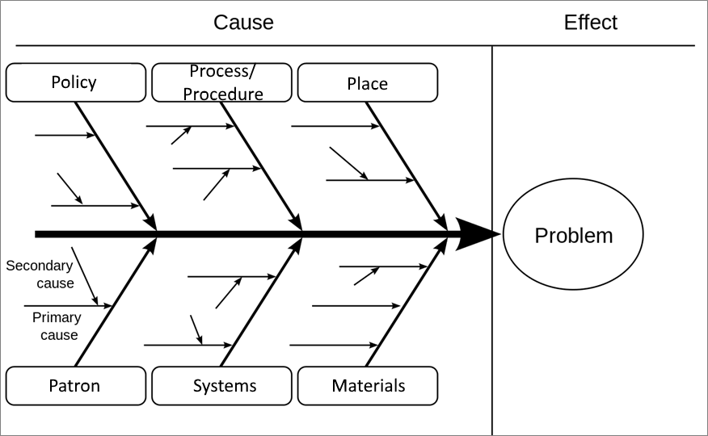
Fishbone/Concept Map
By FabianLange at de.wikipedia - Translated from en:File:Ursache_Wirkung_Diagramm_allgemein.svg, GFDL, https://commons.wikimedia.org/w/index.php?curid=6444290
Notes:
Don’t get too hung up on how many spines and how deep. 6 is common, you can do less.
Some folks only do primary cause, if you choose to do secondary cause, think about going one spine at a time
Too structured? Think about it as a very structural concept map…which means you could just do a freeform concept map if it suits you better
There is always a people component, you need to get people represented in some way
Once you get to a root cause, what is the specific question you have about trying to solve for that cause. Once you have that, you can start crafting data to answer it.
Prefab categories to use in a service environment:
Policy
Process/Procedure
Place
Patron
Systems

Slide 16
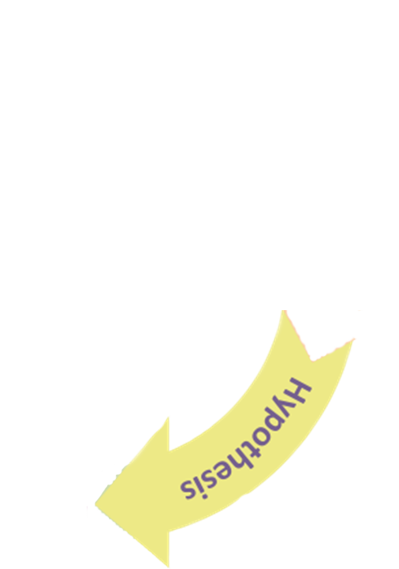
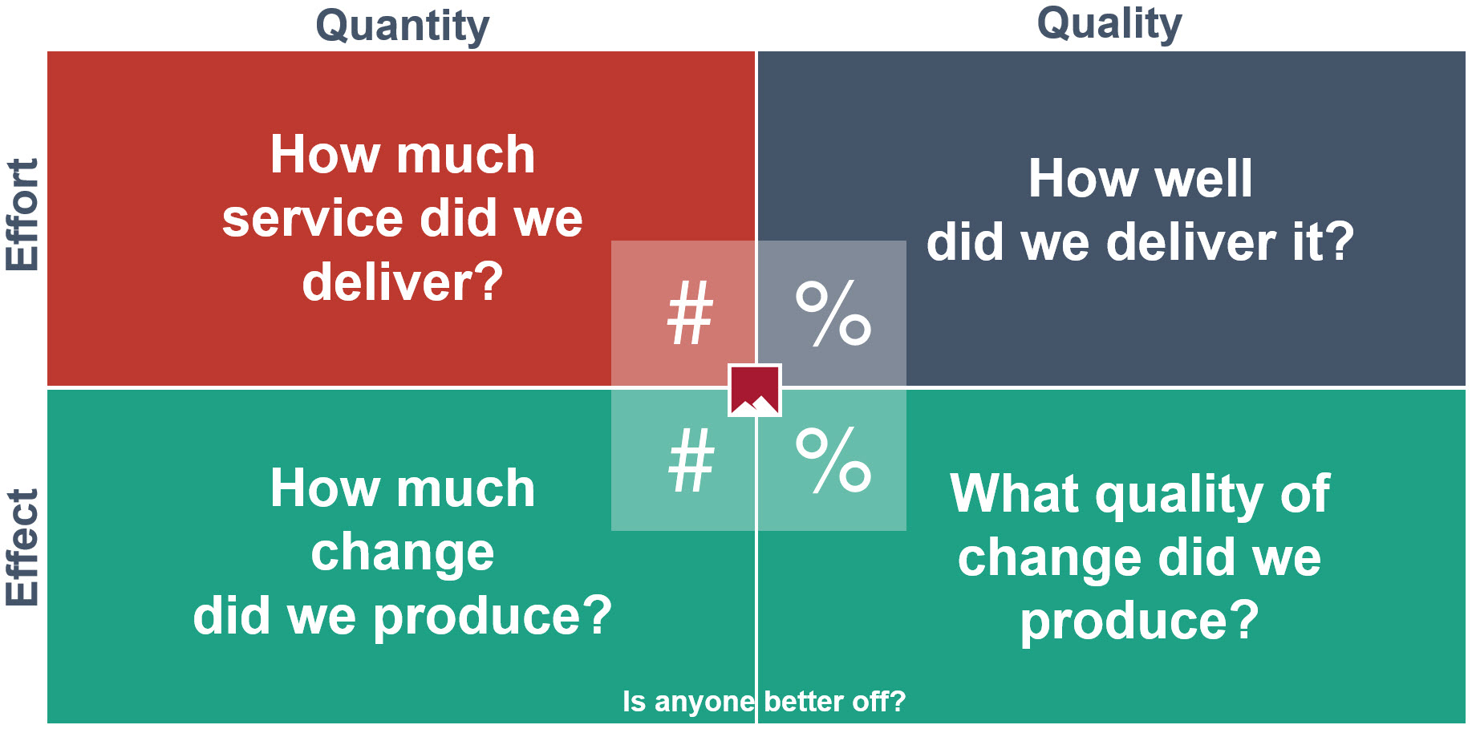
Keywords: Results-Based Accountability, Performance Measures
Use: Creativity and community
Avoid: Forcing existing data fit
Image from Clear Impact website - https://clearimpact.com/common-good-vermont-releases-advice-rba-implementation/
Notes:
Now that you have your root cause influenced specific question, time to figure out what measurements we can use to answer that question.
Performance Measures are all about asking a central question and then identifying the data to support that question
This is a tool you can use to develop data but also to measure over time.
You may not have made anyone better off yet, that’s okay. How WILL you measure if there is positive impact.
Anything observable is measurable, but you may need to use your community and get creative about how you can measure. Don’t just rely on your own imagination.
You might already be tracking data that you can use for this effort, but odds are you need specific data for your specific question, so don’t be tempted to force the existing data to fit if it doesn’t

Slide 17
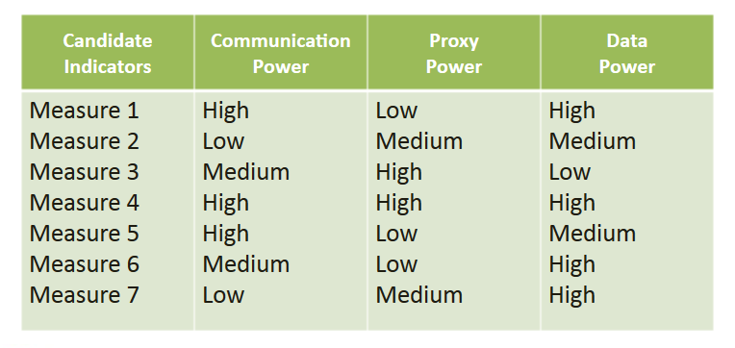
Performance Measures
Image from LSP Institute Slides - http://slideplayer.com/slide/4633686/
Notes:
Once you’ve creatively come up with a bunch of possible measures, you need to consider the impact of those measures:
Rate your measures based on their power to ensure that you pick the strongest measures for the most impact overall.
If it doesn’t have at least one high mark, it’s probably not the best measure to focus on.
Data on it’s own is not meaningful. It is just information. Meaning is created by data in context. This is how you select for the best contextual potential.
What the ratings mean:
Communication Power – does this measure speak to a large and diverse audience. Will the impact of this measure be clear to anyone who looks at it. How well does this measure speak to a broad audience.
Proxy Power – does this measure say something about the central importance of the desired result or outcome. How well does this measure speak to your central question. Does impact of this measure impact other measures in tandem.
Data Power – does this measure produce data that is timely, reliable and consistent. Can this data be collected and measured regularly over time.

Slide 18
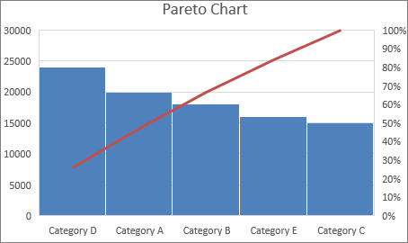
Keywords: Pareto Analysis/Chart
Use: Greatest Impact
Avoid: Trivial Many
Image from Microsoft Office Support website - https://support.office.com/en-us/article/create-a-pareto-chart-a1512496-6dba-4743-9ab1-df5012972856
Notes:
So you go out, you measure for a while, you get a lot of good baseline data. How do you know where to focus your efforts
Pareto was an Italian economist who is responsible for the 80/20 rule (80% of effects come from 20% of causes)
Math power – use this chart to mathematically sort your data and determine which are your 80/20 issues
Now you have proof of where to concentrate your efforts, so tackle the big problems first. Don’t be tempted to pick away at the a lot of small problems for tiny impact, it wastes time and burns out staff

Slide 19
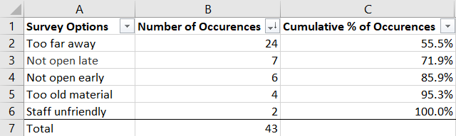
Pareto Analysis
Image modified from State of Vermont Pareto Chart template
Notes:
Shows the relative importance of data in context with all the data
A great way to sort and prioritize survey data for visual impact
What if the biggest effect is from a cause that cannot be changed? Try unpacking that monument into smaller bite sized chunks. Or, go to the first one you can, but use this as a way to make the argument for tackling that big piece with those that how the power to enable it.
Even though you may be solving an emotional problem, this is an objective support for the solution of that problem. It wins hearts and minds.
Pareto charts are native functionality in Excel. Click the photo credit in the previous slide to learn how!
From here, you are well equipped to begin experimenting with solutions, analyzing results, and developing conclusions based on real science.

Slide 20

Action, not reaction
Collaboration, not cowboy
Root causes, not superficial questions
Craft data to answer questions
Choose impact over the trivial many
Image from Stevie Spiers, CC BY-NC-SA 3.0 - https://www.flickr.com/photos/stevies_snaps/15731240486/
Notes:
Even if you don’t use any of the tools, or choose totally different tools, take these into your practice and you’ll be in great shape:
It’s human nature to react. Pause and plan. How can this reaction be turned into productive action.
We are stronger together, we are better together. In the connected age, there is no reason to be a cowboy.
Even if you don’t get it right on the first try, attempting to get at a root cause will set you on a path to a better question to explore.
If your existing data and use of it were enough, you wouldn’t be here. Create data for your questions, you’ll get precise answers.
Focus on the biggest impact to pour time and money into, even if it’s so much more work. The pay off will be so much better than scratching a the little problems.

